Slide 1
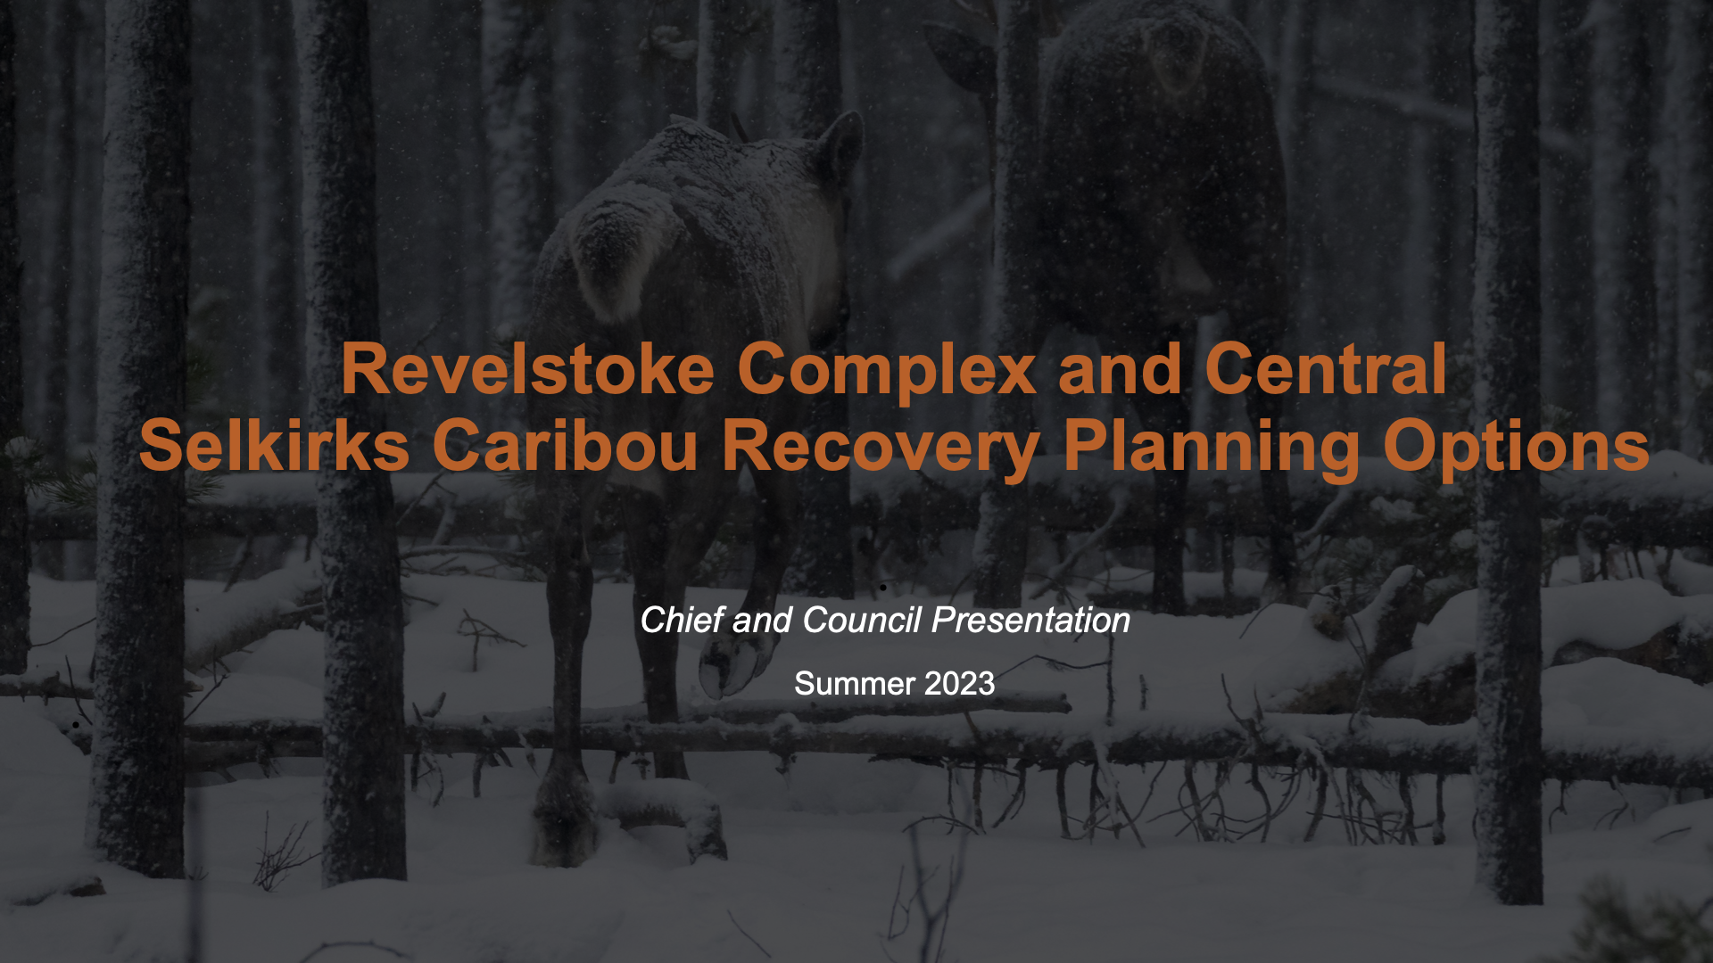

Slide 2
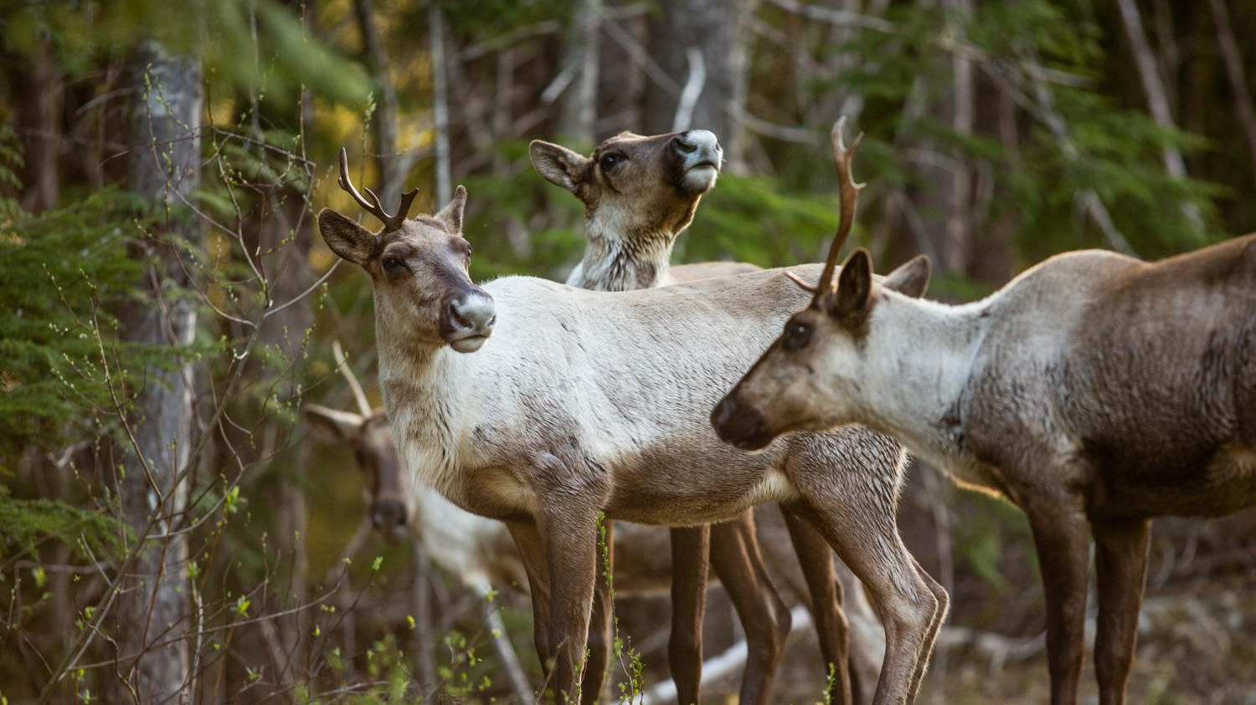
The Ultimate Goal
To produce a unified, evidence-based, and “caribou-first” habitat protection plan.
Make a recommendation on habitat protection option
Moskowitz 2018
Notes:
will look at suggestions to explore making Core and Matrix slides, clearer, the current state, and Pros/cons for caribou for each option. Risks/costs for each option. federal process/threshold.

Slide 3
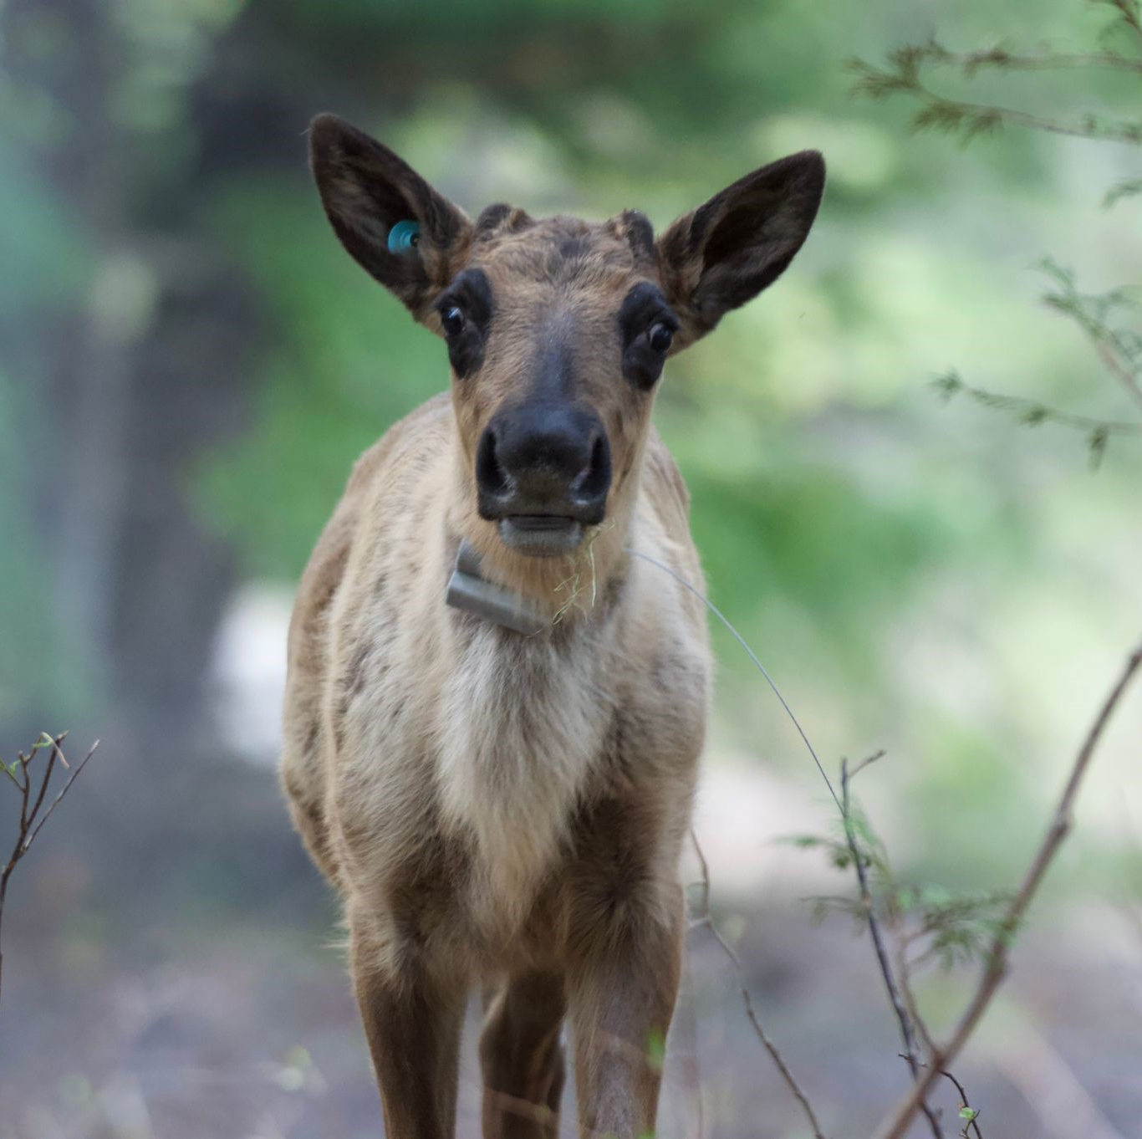
Revelstoke Complex and Central Selkirks Caribou Technical Working Group - Who is involved?
9 Indigenous Nations/communities
Splatsin, Okanagan Nation Alliance, Adams Lake Indian Band, Shuswap Band, Ktunaxa, Nation Council, Simpcw First Nation, ʔaq'am,mSkwlāx te Secwepemcu’lecw, Qwelmínte Secwépemc
British Columbia
Provincial representatives from the Caribou Recovery Program, Research (old growth), District MOF, Region MOF
Canada
Canadian Wildlife Service, Parks Canada
Independent Caribou Scientists
Biodiversity Pathways
Notes:
First meeting April 2021 with 3 Nations. Online and face-to-face meetings
Lots of information sharing, Understanding of habitat protection being the main one
The approach pairs short-term recovery actions such as predator reduction and caribou guardians at the Central Selkirks ‘maternity pen’ set up for calving season, with ongoing work to secure habitat and landscape-level protection in an effort to create a self-sustaining caribou population.
*Ministry of Forest
*BC Caribou Recovery Team
*Qwilimite
*Have official names

Slide 4
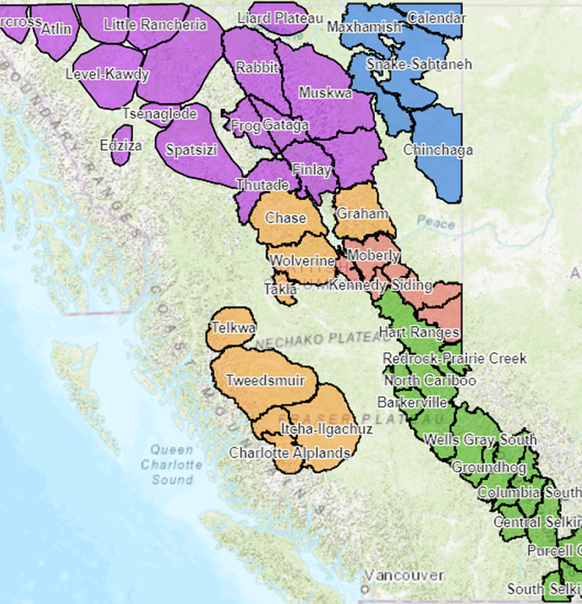
The Legislative Context, Species at Risk Act (Federal)
Federal government responsible for conservation efforts for caribou under SARA (2002)
    Recovery Strategy (2014)
    Southern Mountain Caribou - facing imminent threats to their recovery (2018)
    BC and Canada signed a Bilateral Conservation Agreement - Section 11 of SARA (2021)
      If BC does not act, the Federal government would instigate protection order.
      The Technical Working Group was formed under this agreement
https://www.canada.ca/en/environment-climate-change/services/species-risk-public-registry/conservation-agreements/southern-mountain-caribou-british-colombia-2020.html
Notes:
A Conservation agreement minimizes the risk of the Protection Order from the Federal government

Slide 5
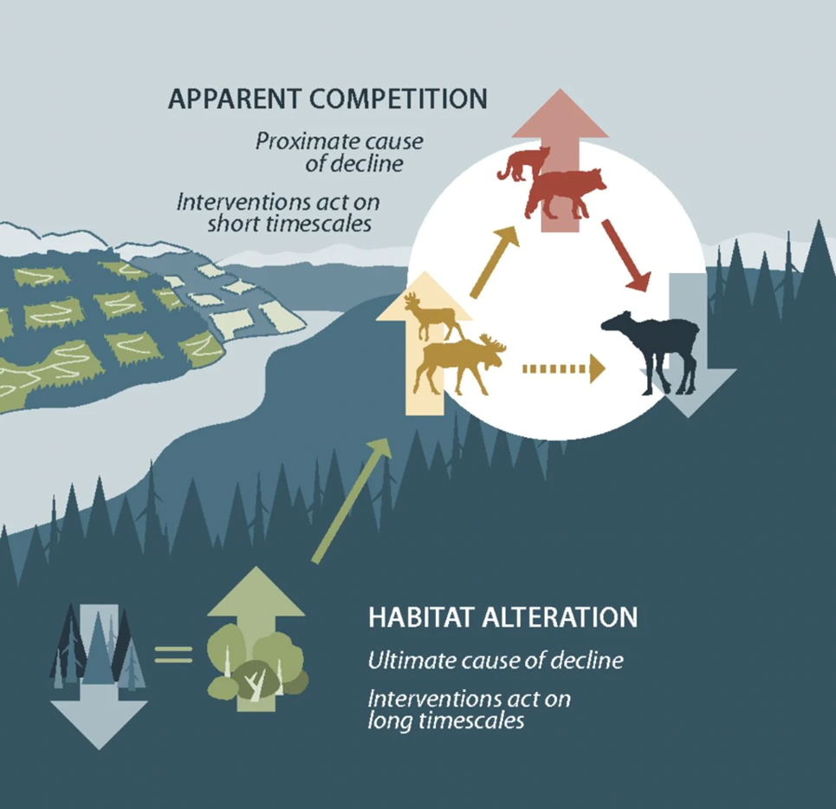
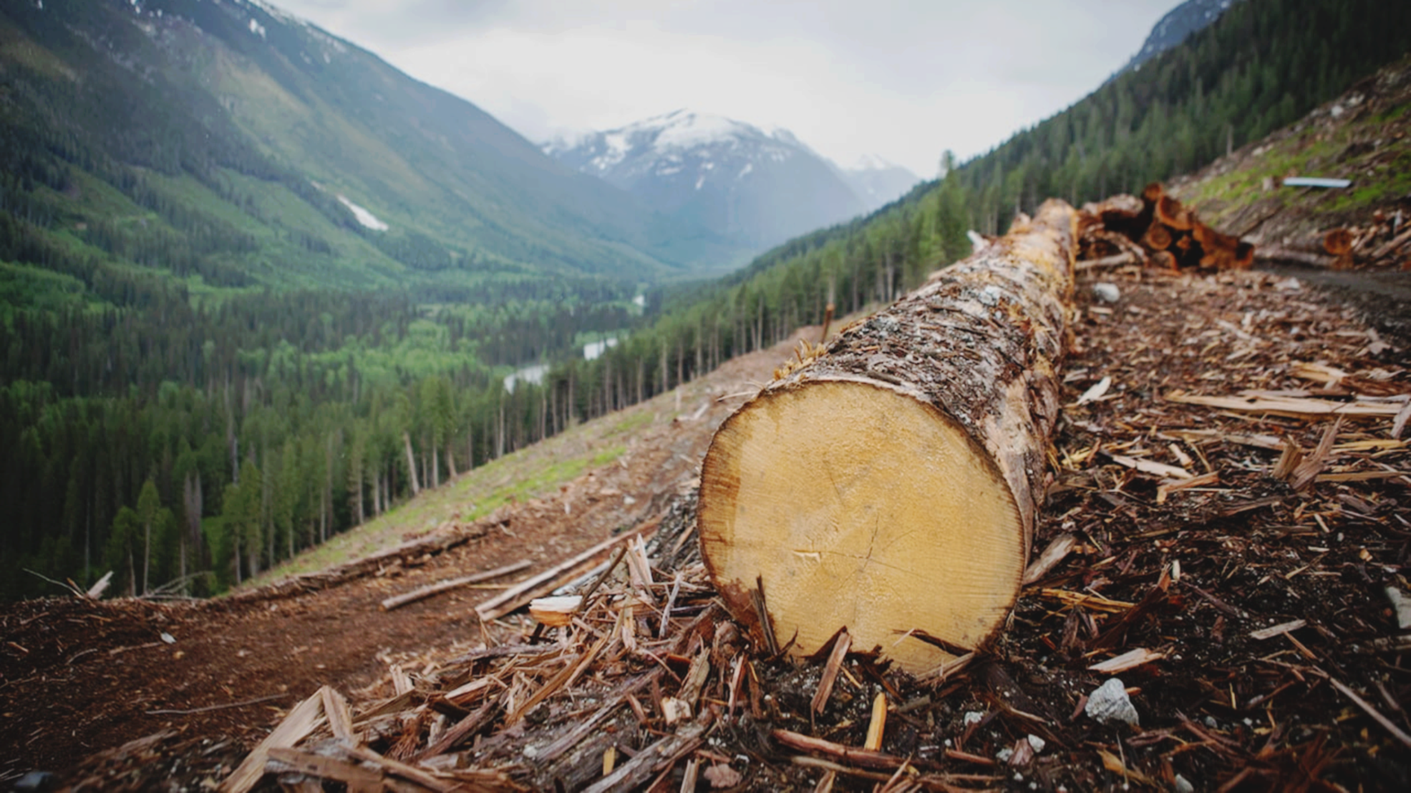
The problem, and the long-term solution
A quickly changing landscape
Vernett & Kulkarni 2022 - CBC
Serrouya et al. 2019
Notes:
ADD MORE
Spend more time explaining this - background.
Why we need to manage predators and moose (short-term levers)
Focusing the presentation on habitat
Because of the forest state…. We need to do short-term measures

Slide 6
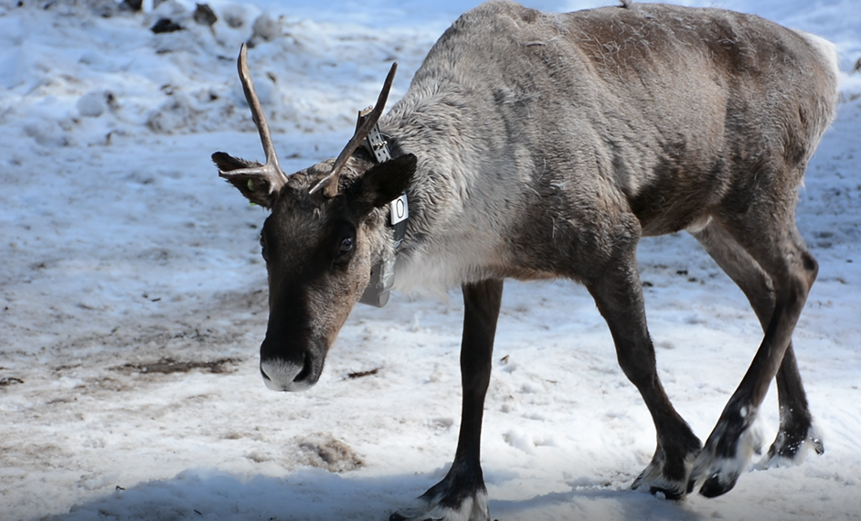
Disclaimer
Southern Mountain Caribou are not at risk because of First Nations and the actions of Indigenous People.
Caribou are at risk because of habitat alteration that supports alternate prey and associated predators

Slide 7
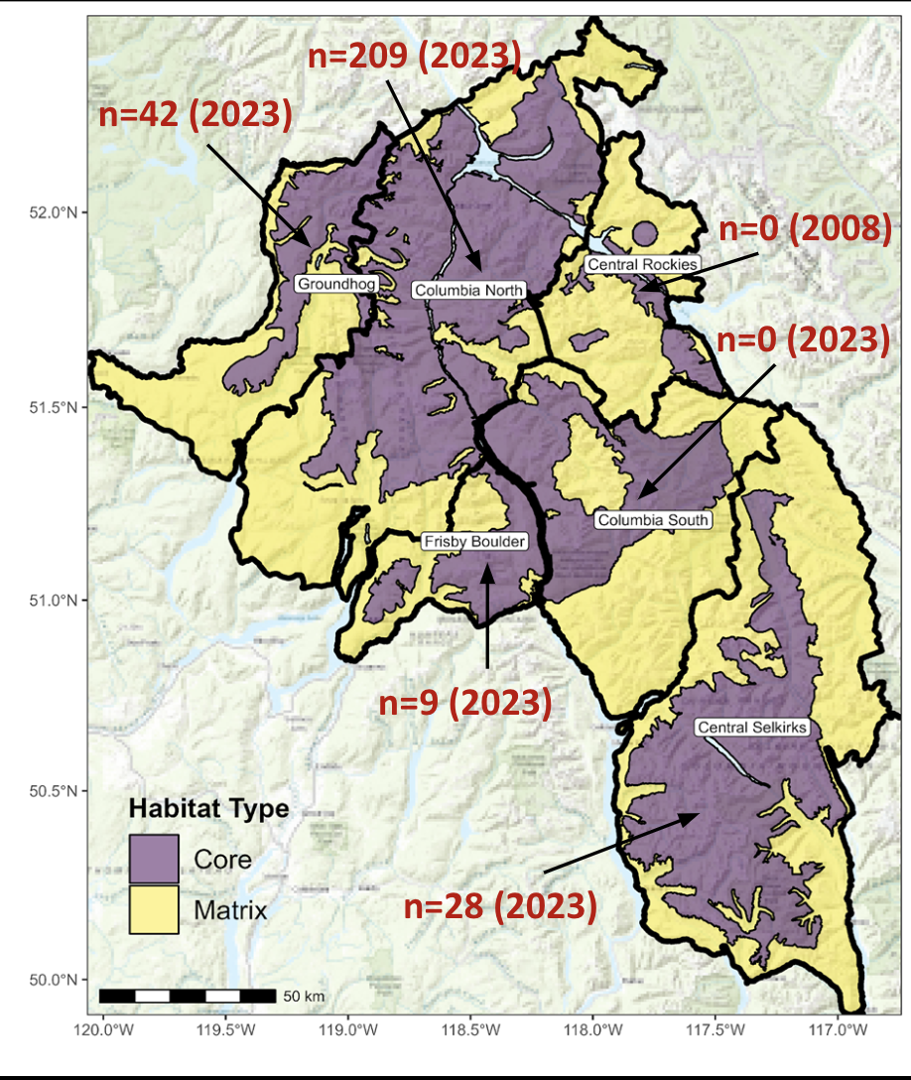
Revelstoke Complex and Central Selkirks Caribou Recovery Plan
ihttps://bc-crp-apps.shinyapps.io/RCCSCTWG_Dashboard/_w_ae12df1d/_w_0bf7828d/
Core: Used directly by caribou – necessary habitat for survival
Matrix: surrounds Core, where predator/prey dynamics impact caribou. Not directly used by caribou
Notes:
CORE habitat (where caribou live) for most herds, some gaps.
MATRIX habitat (surrounds Core, where predator/prey dynamics impact caribou) disturbance exceeds identified target.
**Change

Slide 8
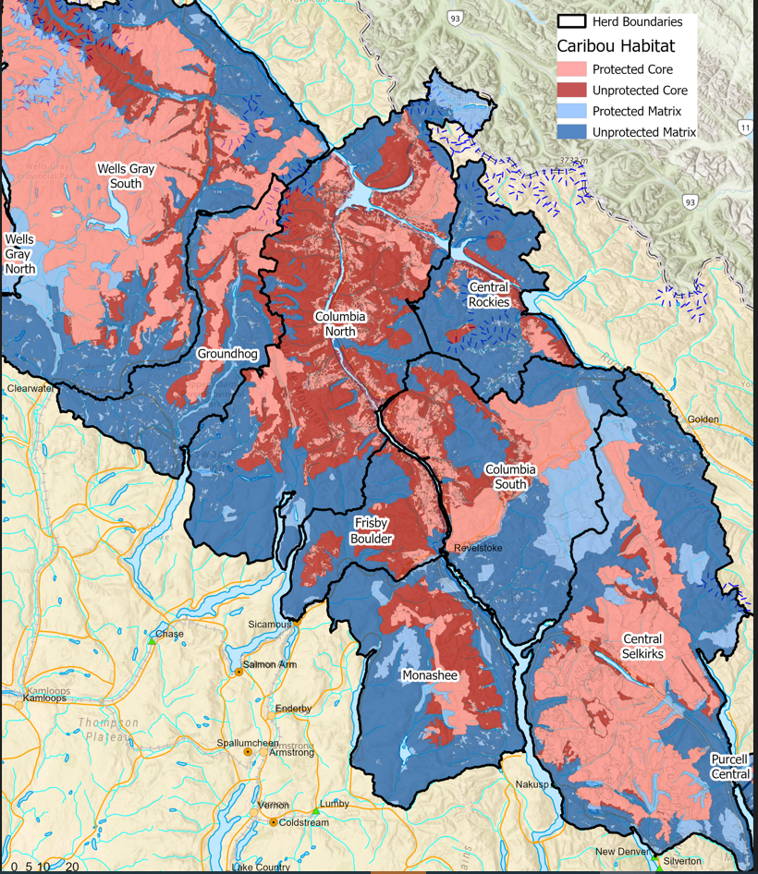
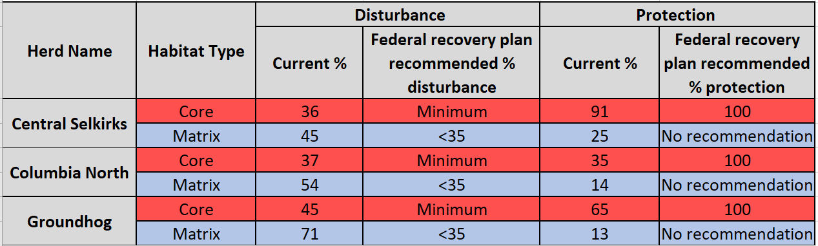
Revelstoke Complex and Central Selkirks Caribou Recovery Plan
The Landscape- Habitat Status
Notes:
*emphasize the patterns you first see.
*Light is protected, DARK is NOT

Slide 9
Habitat Protection Options
Tier 1- Highest probability of
self sustaining
Tier 2- Moderate probability of self sustaining
Tier 3- Lower probability of self sustaining

Slide 10
Protection Options - Likelihood of Self Sustaining Caribou Population
Old
(Tier 1) High probability
Caribou
Sustained
(Tier 2) Moderate probability
Forest Age
(Tier 3) Lower probability
Caribou
Extinction
Young
Less
More
Predator Management
Notes:
Emhpasize black dot lots of intervention
Kathi — minimum options to recover caribou
Self sustaining – we agree on full protection of core – and matrix natural seral state
SSWA – we don’t know yet – with Kernal – using decision tree – incremental
Borrow language from Dave’s email.
Option 1 – full protection of core – natural forest state for matrix – allow some logging in the matrix
Option 2 – Self sustaining with assistance – prioritize habitat - don’t point to the Uds – put a few dots
- Uds matter in where to put habitat protection

Slide 11
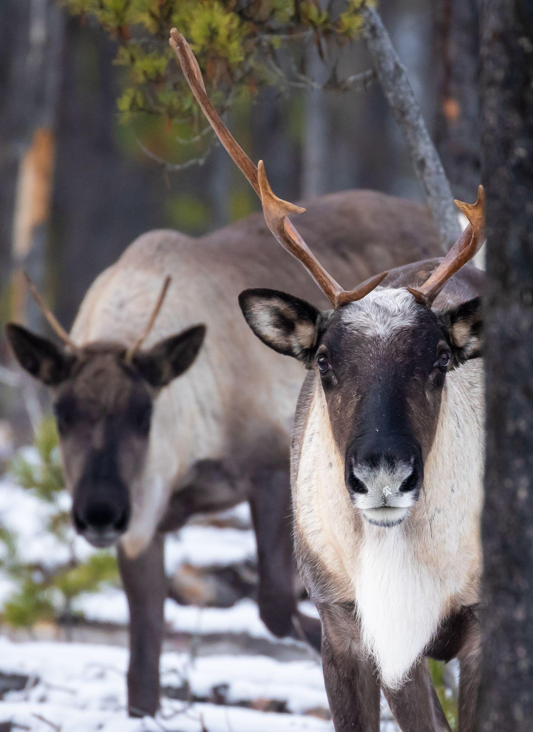
Questions on what we have covered so far?

Slide 12
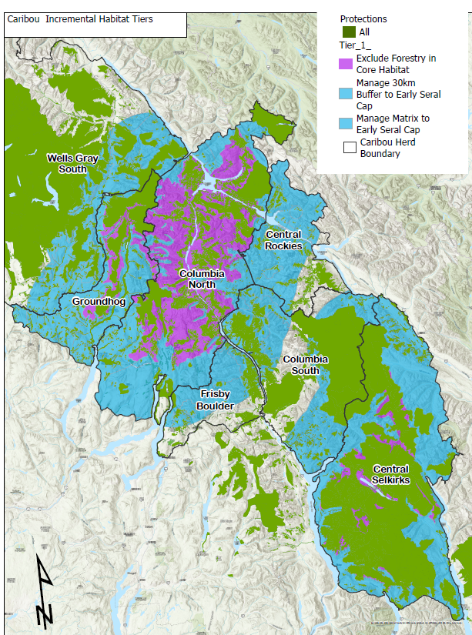
Tier 1:
Highest probability of self-sustaining
Protecting all core that isn’t already protected
Manage all matrix to a maximum 12% young forest (< 40 yrs)
Manage all unprotected area in a 30 km buffer from core to a maximum of 12% disturbance (Forest <40 years)
Notes:
Reference back to what is already protected
Explain why we explained 30km as buffer - zone of influence where moose/deer-wolf habitat is influential to caribou. Close to a wolf’s home range — link to core vs. matrix discussion.
How much of core we are giving caribou a chance to survive in.
*calculate percentage difference in Tier 1 vs. Tier 2.
We modeled adult female survival -
**Darcy – phrasing to options can introduce decision makers focusing on lowest option. Suggest to balance…. Protect core, manage matrix in a way that we don’t need to keep killing wolves.
** lay out the realities of caribou conservstation. Have a new slide -
Summarize as best available options we have agreed upon
ALL the options are intended to allow for recovery

Slide 13
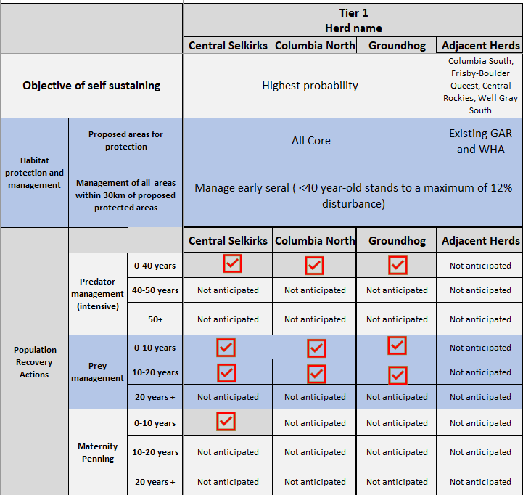
Tier 1:
Highest probability of self-sustaining
Notes:
These are human intervention levers we need to do now.
*Print Out - we have also provided it as a hand-out

Slide 14
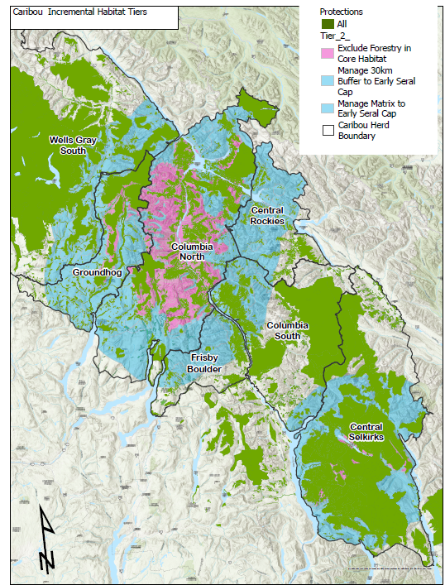
Tier 2: moderate probability of self-sustaining
Protect 95% Utilized Distribution within Core (Central Selkirks, Columbia North)
Protect 90% Utilized Distribution for Groundhog within Core
Managed to a 12% disturbance within the 30 km buffer from the proposed protected area
Notes:
Make clear the differences from Tier 1. Tier 2 is a compromise. Spatial extent of caribou habitat that we are constraining forest harvest
Moderate probability BECAUSE - leads to more moose and deer food.

Slide 15
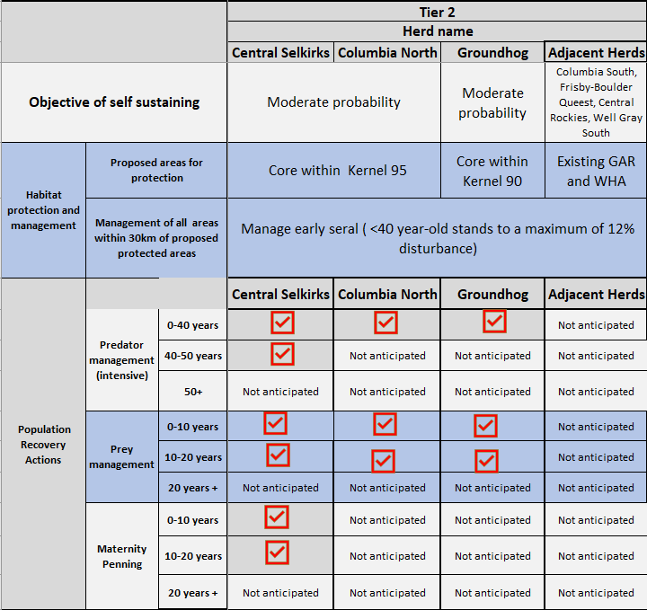
Tier 2: moderate probability of Self-Sustaining

Slide 16
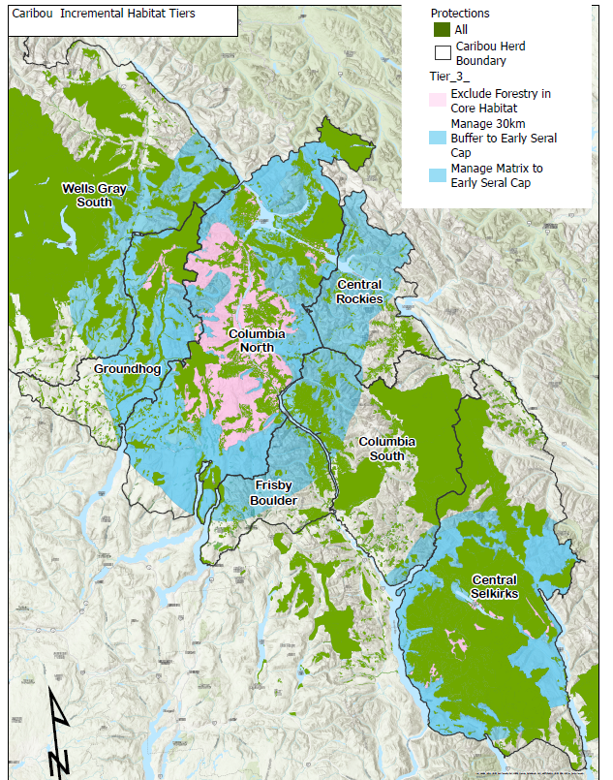
Tier 3:
Lower probability of Self-Sustaining
90% UD’s for Columbia North and Central Selkirk
80% UD’s for Groundhog
Manage all areas outside 90% and 80% UD protection within 30km at 12% disturbance cap
Notes:
Team deems this to be lowest probability of self-sustaining.
Out of the 3 options, this Tier 3 option has the HIGHEST risk of not achieving self sustaining caribou population

Slide 17
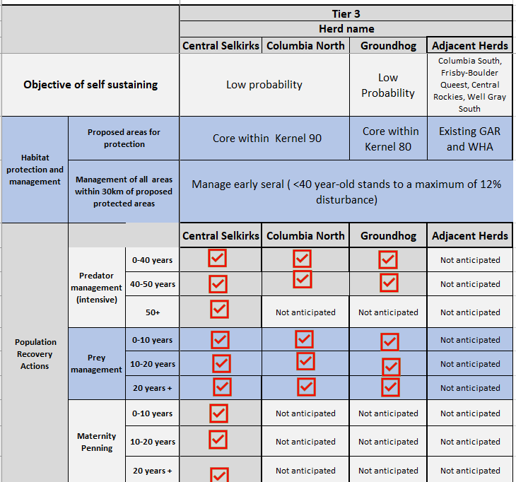
Tier 3:
Low probability of self-sustaining

Slide 19
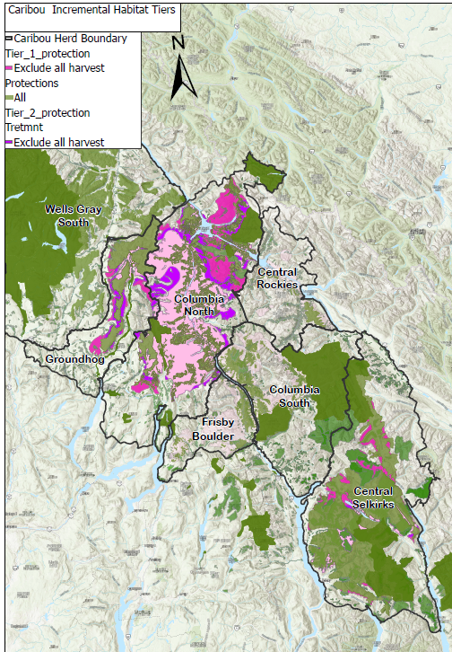
All tiers

Slide 20
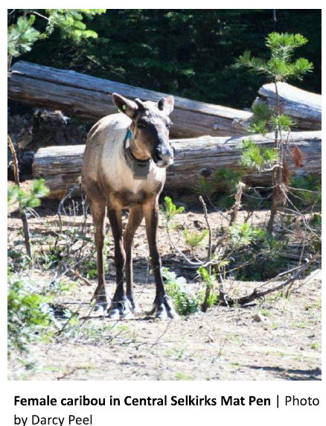
Questions on what we have covered so far?

Slide 21
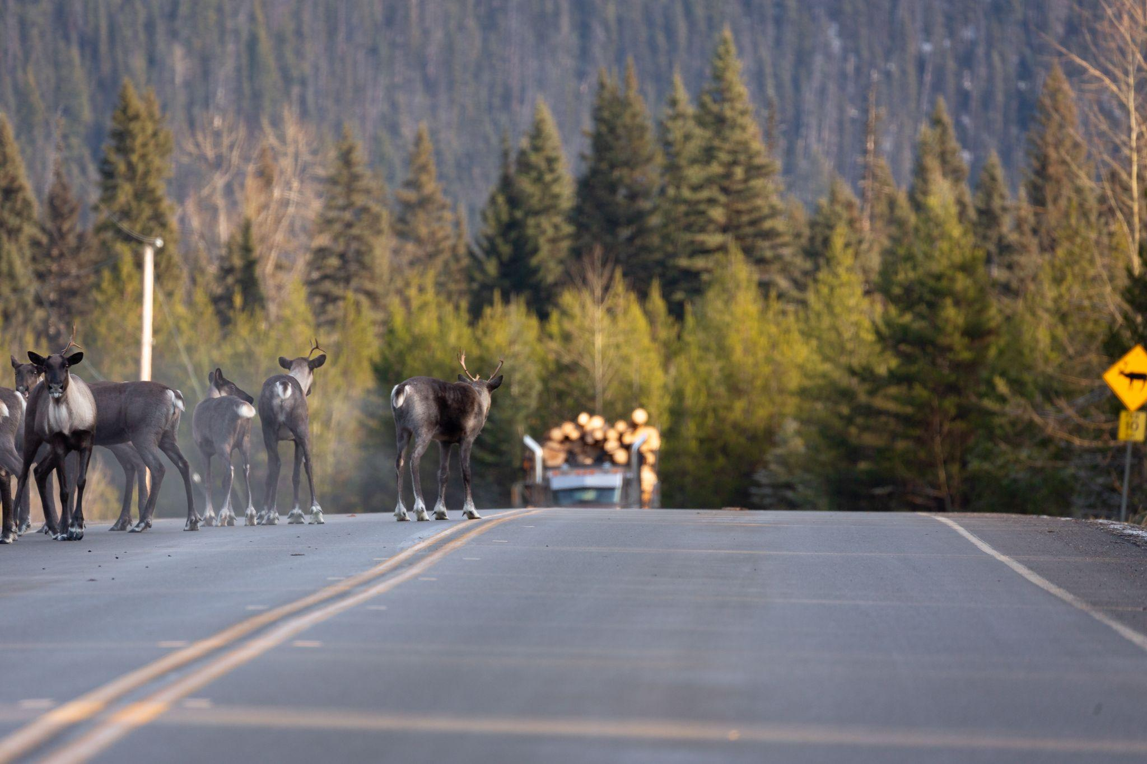
Social, Economic, and Environmental Indicators for Proposed Caribou Habitat Protection Scenarios
Community economic profiles
  The role of forestry
Timber Supply Impacts
  By Protection scenario & Timber Supply Area
Potential economic benefits of increased caribou conservation
  Forest Carbon Offsets
  Restoration Economy
  Conservation Funding
Notes:
We have provided a summary of the caribou biology and proposed options for caribou conservation. This next section focuses on socio-economic issues around caribou recovery with an emphasis on the role of forestry in selected communities, timber supply impacts, and potential economic benefits from increased caribou conservation.

Slide 22
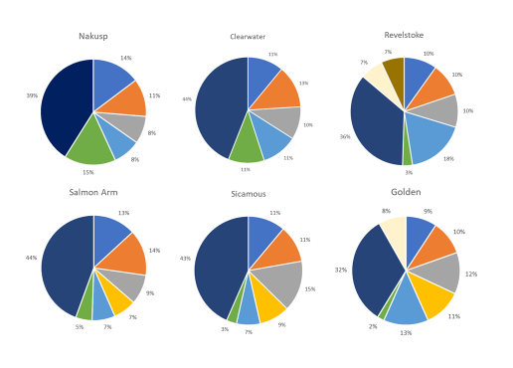
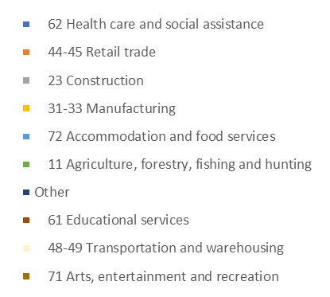
Labour Force Participation by Sector: Key Communities
Charts show top 5 sectors, plus forestry
Health care, Retail, Construction, Tourism (Accom/Food) are top regional employment sectors
Forestry (green) is a top source of employment in Nakusp and Clearwater
Forestry is a smaller source of employment in Revelstoke, Sicamous, Golden, Salmon Arm
Notes:
Forestry is an important, but not dominant economic activity. Conservation will impact jobs, especially in some smaller communities with high reliance on logging.
These figures show the top 5 employment sectors plus forestry in communities surrounding the caribou herds we are discussing. Forestry is shown in green. The biggest dark blue section of the pie graphs is “all other sectors”. What you see is that smaller communities like Nakusp and Clearwater have a percentage of workers in forestry jobs than larger communities like Revelstoke, Golden, Salmon Arm, and Sicamous.
This does not tell the full picture of the forestry economy, but it does provide one indicator of the role of forestry here. Regardless, the group recognizes that restoring caribou is likely to impact forestry jobs, and community supports and transition will be required to help workers

Slide 23
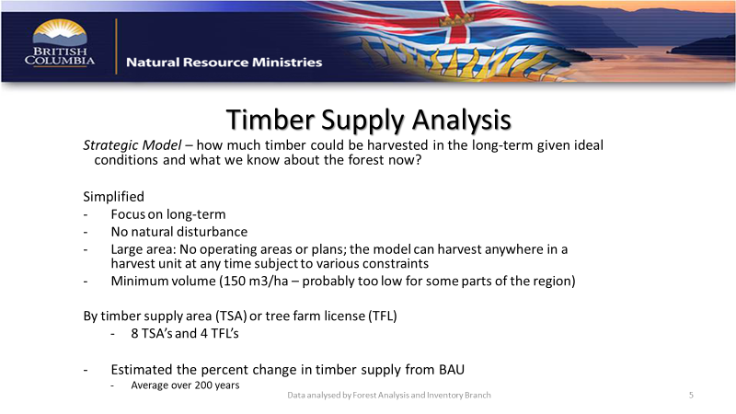
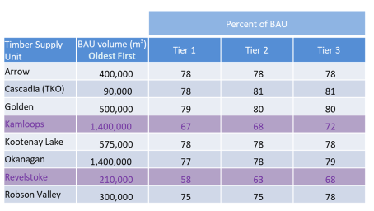
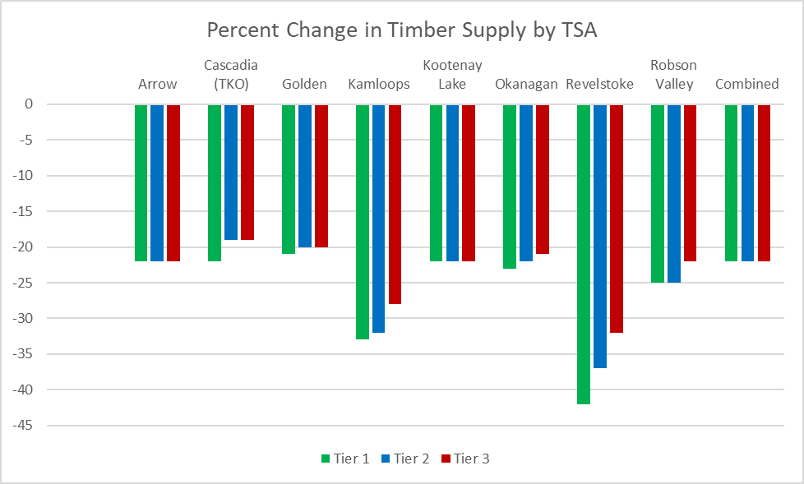
The following numbers do not include the 30 km buffer areas managed to a 12% disturbance cap within the non-priority herds. The Volume impact is being recalculated.
Notes:
Impacts to forestry will be substantial from caribou conservation, especially at local scales. The table on the left shows the Allowable Annual Cut, by caribou protection Tier, as a percentage of Business as Usual, and the figure on the right shows the same information as a graph.
Overall, the impact is projected to be ~ 22% reduction in AAC, across all Tiers. However, the impact is much higher across all Tiers in Kamloops, Okanagan, and Revelstoke TSAs because this is where most of the new protections for the Columbia North herd are.
This assessment is based on a coarse-scale timber supply analysis covering very large areas across 8 TSAs and 4 TFLs (data not shown). Additional detail is available for timber supply impacts.

Slide 24
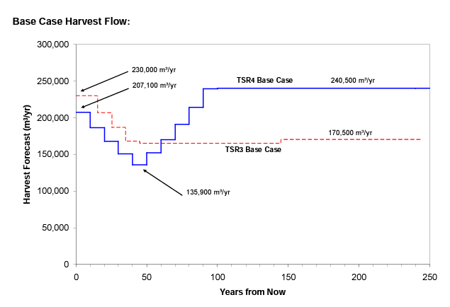
Even without increased conservation for Caribou and Old Growth, Timber Supply is projected to decline
Revelstoke TSR
TSR: In 2011, timber supply was anticipated / planned to decline by ~ 40% by 2040.
TSR: In 2011, timber supply was anticipated / planned to decline by ~ 40% by 2040.
Notes:
Based on current timber availability, most of the proposed areas are “scheduled” (in timber supply models) for harvest over the next ~25 years. Following the model projections, timber supply will drop, and forestry will have to transform regardless of conservation decisions (e.g., mills will need to shift to harvesting less volume and smaller trees). This transformation can happen now, with protection of caribou habitat (and old growth forests), or it can happen in 20-25 years after most natural, old forests are converted to young managed stands.

Slide 25
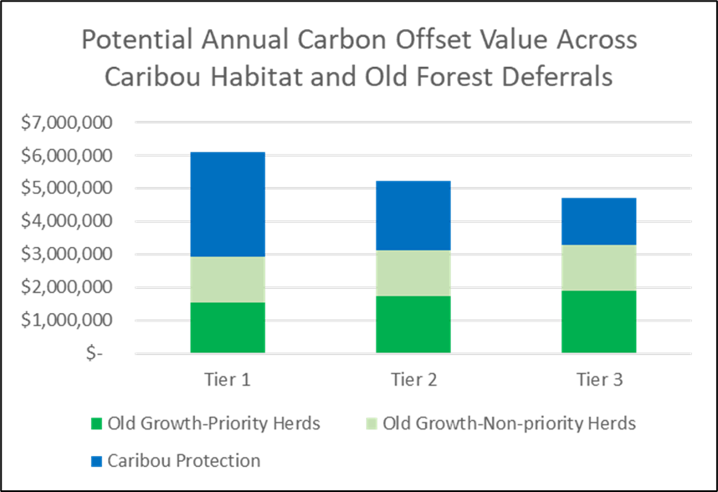
Some Opportunities for Economic Benefits
Forest Carbon Offsets
Carbon offset potential is estimated at
    ~$6.1mil/yr (Tier 1)
Restoration Economy
Supporting workers and Indigenous Nations in working to restore ecosystems
Conservation Funding
Governments and private donors are interested in supporting conservation led by Indigenous Nation
Carbon pricing varies. The graph here shows pricing for $15/tCO2e across the three protection scenarios plus old growth forests outside of core caribou protection within matrix habitat and non-priority herd boundaries
Carbon pricing varies. The graph here shows pricing for $15/tCO2e across the three protection scenarios plus old growth forests outside of core caribou protection within matrix habitat and non-priority herd boundaries
Notes:
This slide shows some of the opportunities that the group has discussed for introducing economic benefits. We have additional information, and can provide it if people want more details.
Forest carbon offsets are one option to provide transitional funding for Indigenous Nations in support of conservation. Southern mountain caribou live in the rainforest, where large amounts of carbon are stored in older forests. Conserving habitat for caribou and old growth has the potential to generate income for Indigenous Nations that is similar (or much greater, depending on carbon pricing) to current Forestry Revenue Sharing Agreements. This has co-benefits, including helping to mitigate climate change impacts including increased flooding, forest fires, heat domes, and weather extremes. Carbon is not the full solution to economic transformation, and additional measures would be needed to transform economies to activities that support the persistence of caribou. This could include shifting local economies towards the “restoration economy” and other economic sectors as well as seeking “conservation funding”.
Carbon offsets and a transition to a conservation economy would require collaboration and planning from Indigenous Nations, and will depend on choices made by Indigenous communities. The Great Bear Rainforest provides one example of a conservation-focused, Indigenous-led process. The BC Assembly of First Nations has also developed resources for First Nations carbon. This information can be provided.

Slide 26
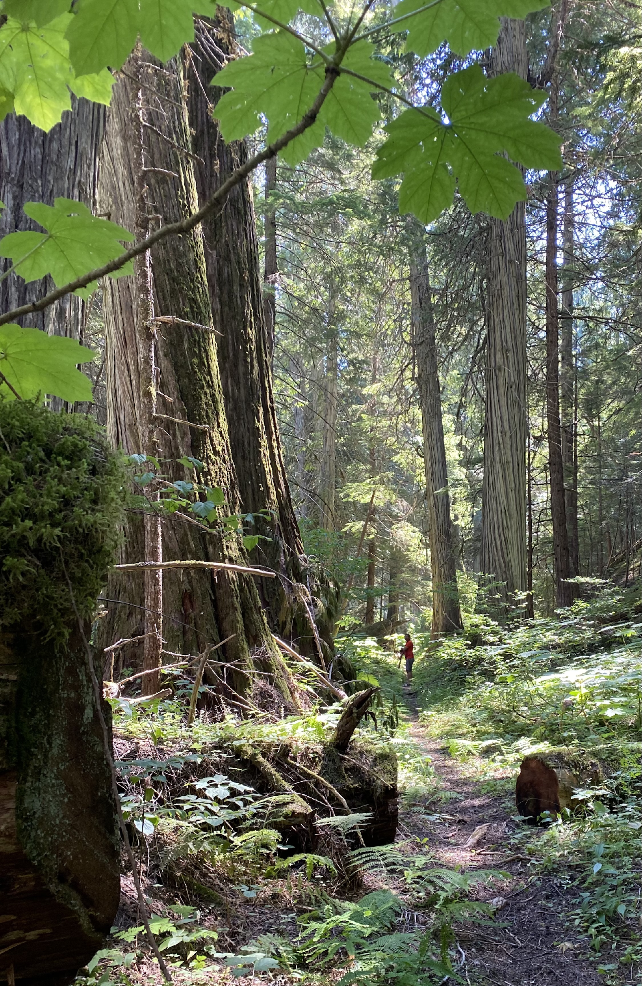
The Landscape & Biodiversity
Caribou = umbrella species (and indicator) for ecosystem health and resilience
Protection of caribou habitat is critical for the future health of caribou populations

Slide 27
Summary
Tier 1 Tier 2 Tier 3
Increase risk to caribou from predators
Increase interventions to maintain caribou = increase amount of funding necessary
Less critical habitat protected
Smaller population and potential extirpation of some herds

Slide 28
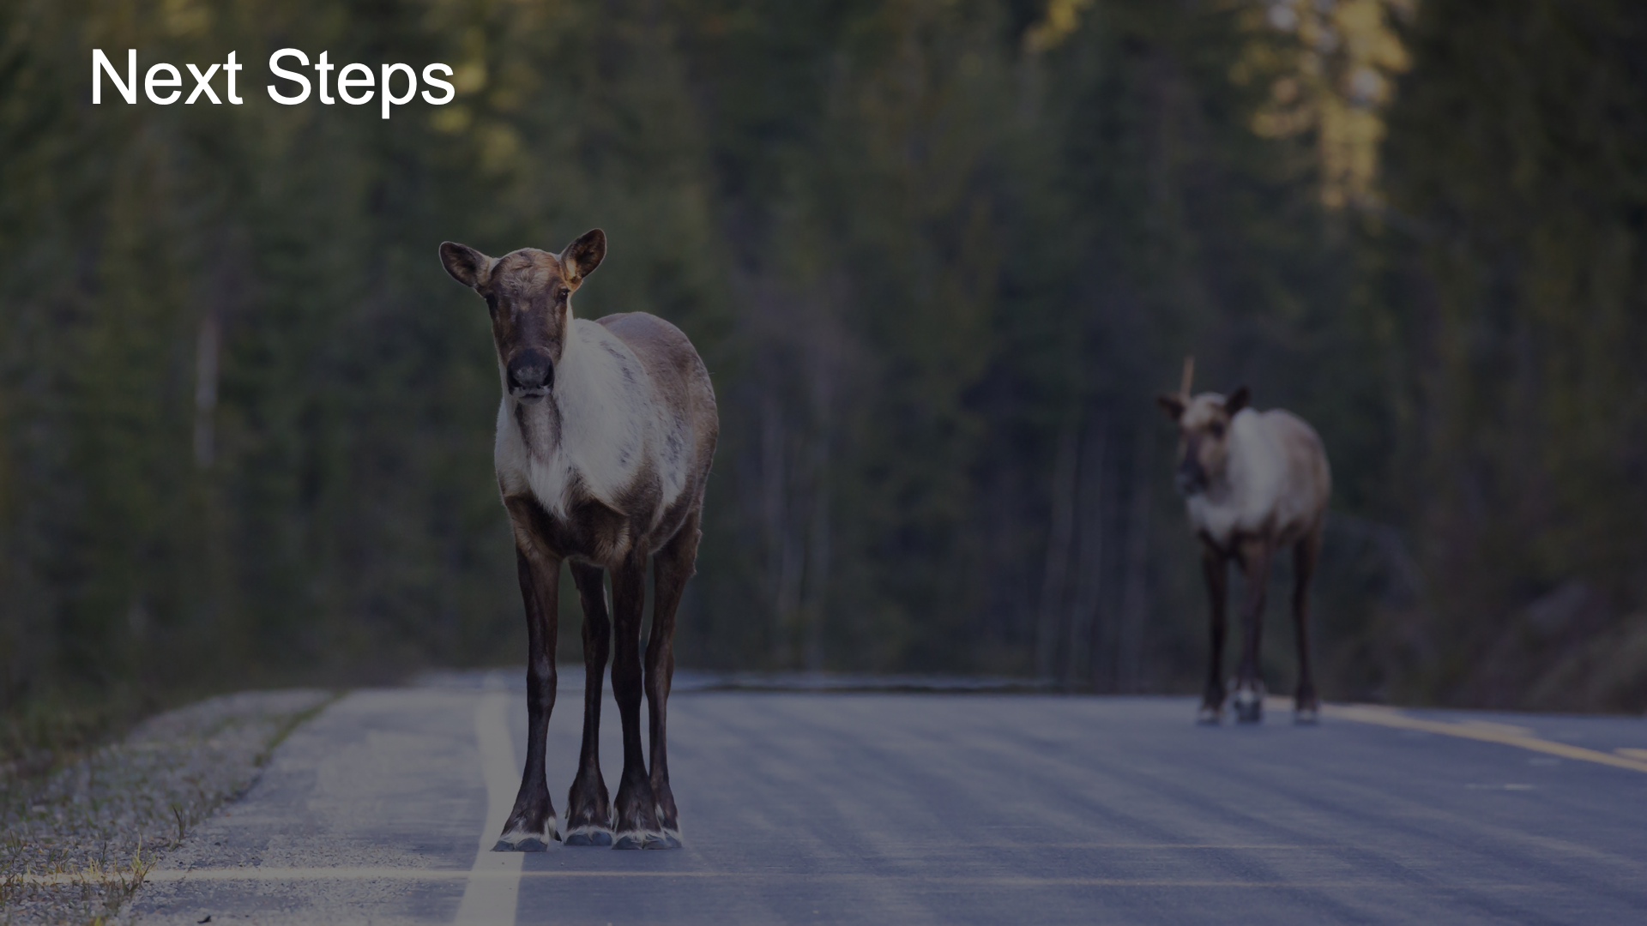

Slide 30
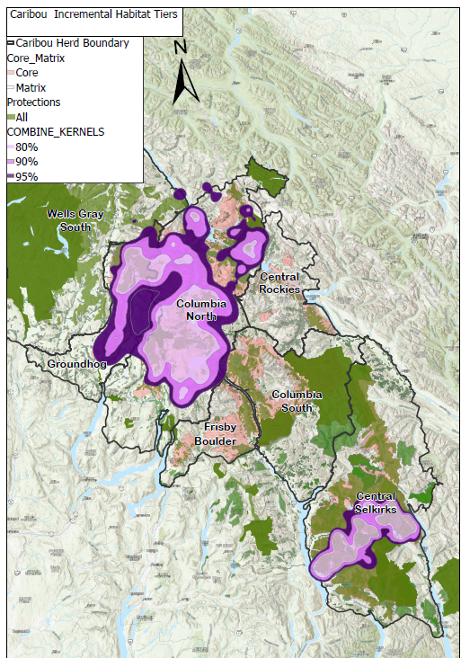
APPENDIX

Slide 31
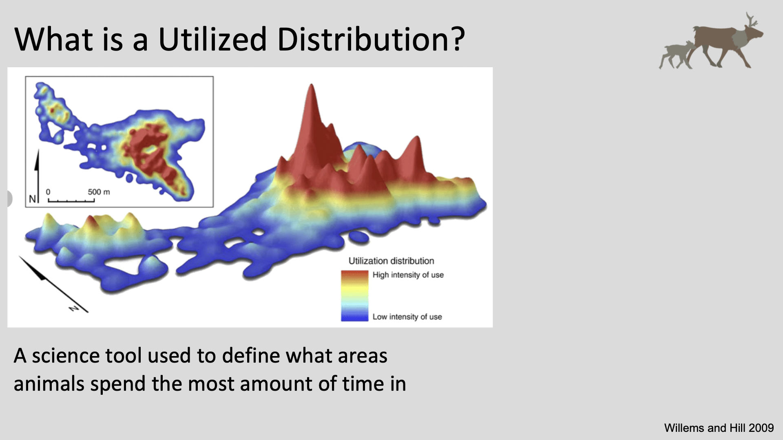

Slide 32
Revelstoke Complex and Central Selkirks Caribou Recovery Plan
Today’s objectives
Understanding the complexity and uniqueness of the Revelstoke Complex and Central Selkirks Caribou Areas and TWG
  The legislative context
  The People
  The Landscape
  The Caribou
  The Habitat Protection Tiers
  The social and economic context

Slide 33
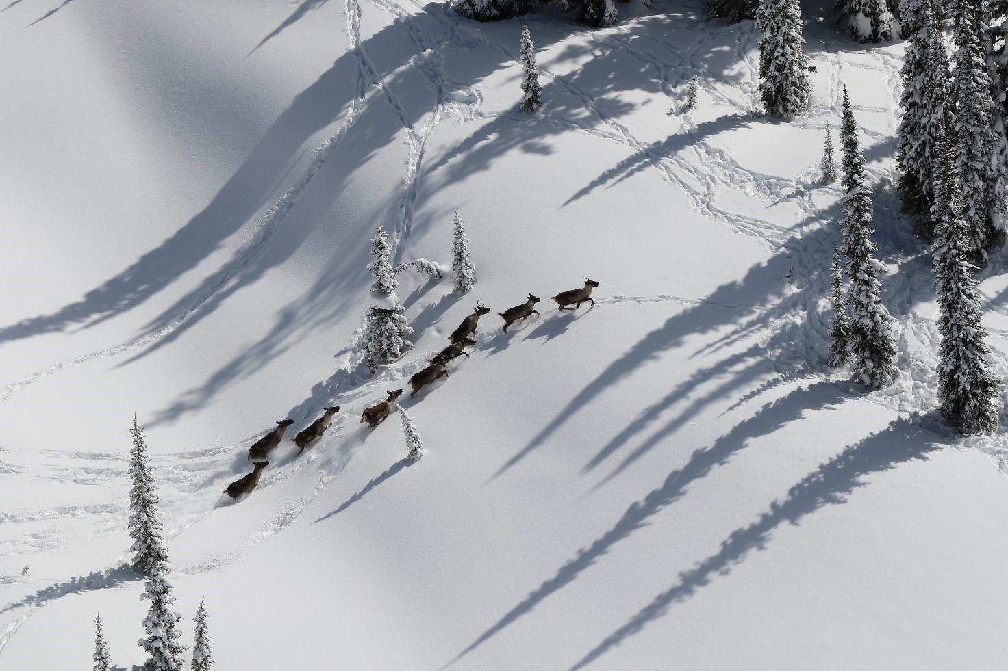
The legislative context
UNDRIP, DRIPA
On Nov. 28, 2019, B.C. implemented the UN Declaration through legislation by passing the B.C. Declaration Act.
commitment to Reconciliation
Reconciliation In the TWG context: supports the collaborative work on the co-development of recommendations for caribou recovery
The TWG is embracing its work through an ethical space approach.

Slide 34
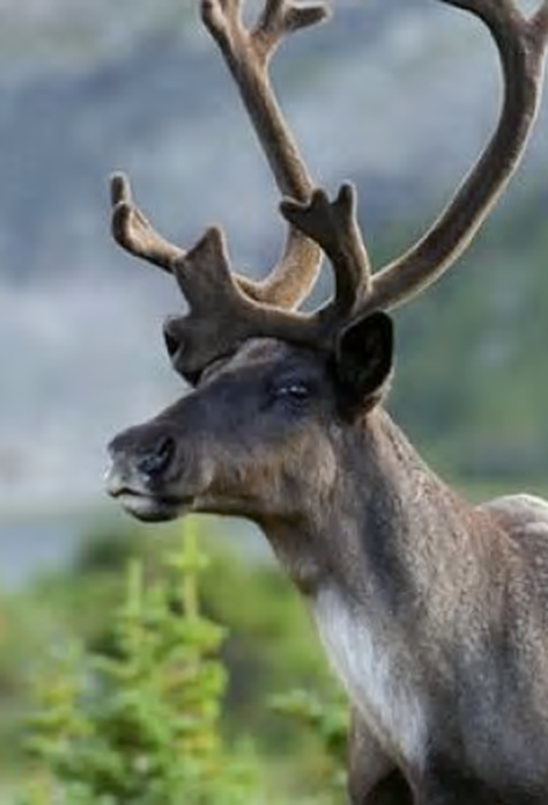
The legislative context and the Revelstoke Complex and Central Selkirks Caribou Technical Working Group
Through the Canada-BC Section 11, BC has committed to collaborate with First Nations (Sec.7) and engage with communities and stakeholders (Sec.8) to support the recovery of southern mountain Caribou to self-sustaining populations.
And to
Developing and implementing Conservation and Recovery Measures.
.
The Technical working group is one option for collaboration under section 7
Notes:
Sect 7 of the agreement defines how collaboration and participation can be done: working groups is one option.

Slide 36
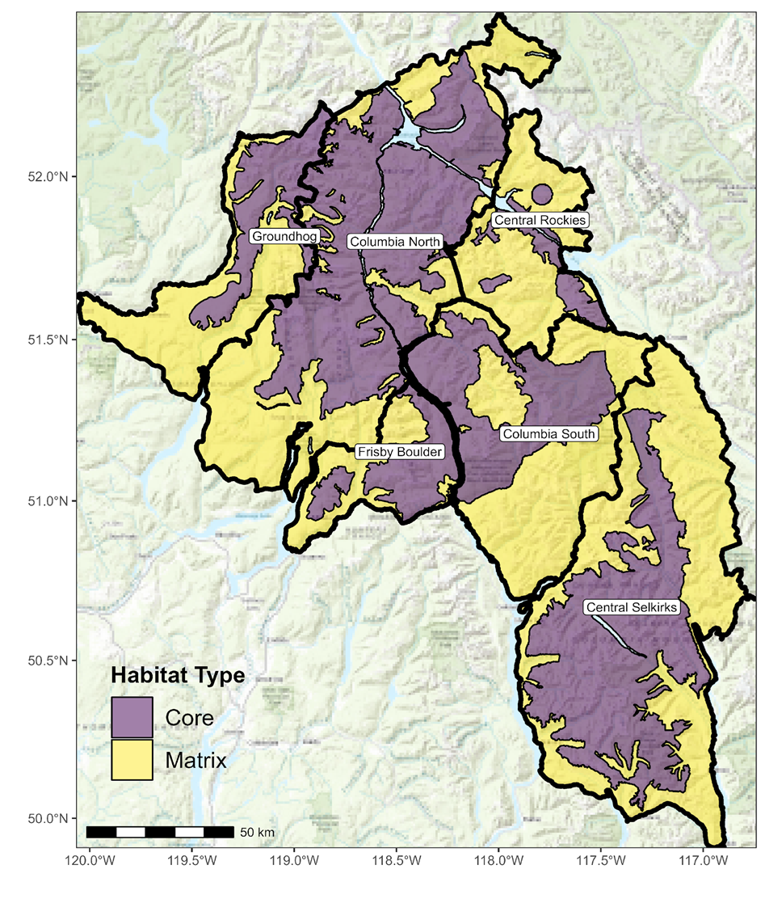
Revelstoke Complex and Central Selkirks Caribou Recovery Plan
n=209 (2023)
n=42 (2023)
n=0 (2008)
n=0 (2023)
6 herds within RCCS
3 priority herds where recovery is likely: Columbia North, Groundhog, and Central Selkirks
Efforts : Maternity penning, Predator management, Prey management, habitat restoration, additional habitat protection and Matrix management
The most critical action for recovery is habitat protection
n=9 (2023)
n=28 (2023)
Notes:
CORE habitat (where caribou live) for most herds, some gaps.
MATRIX habitat (surrounds Core, where predator/prey dynamics impact caribou) disturbance exceeds identified target.

Slide 38
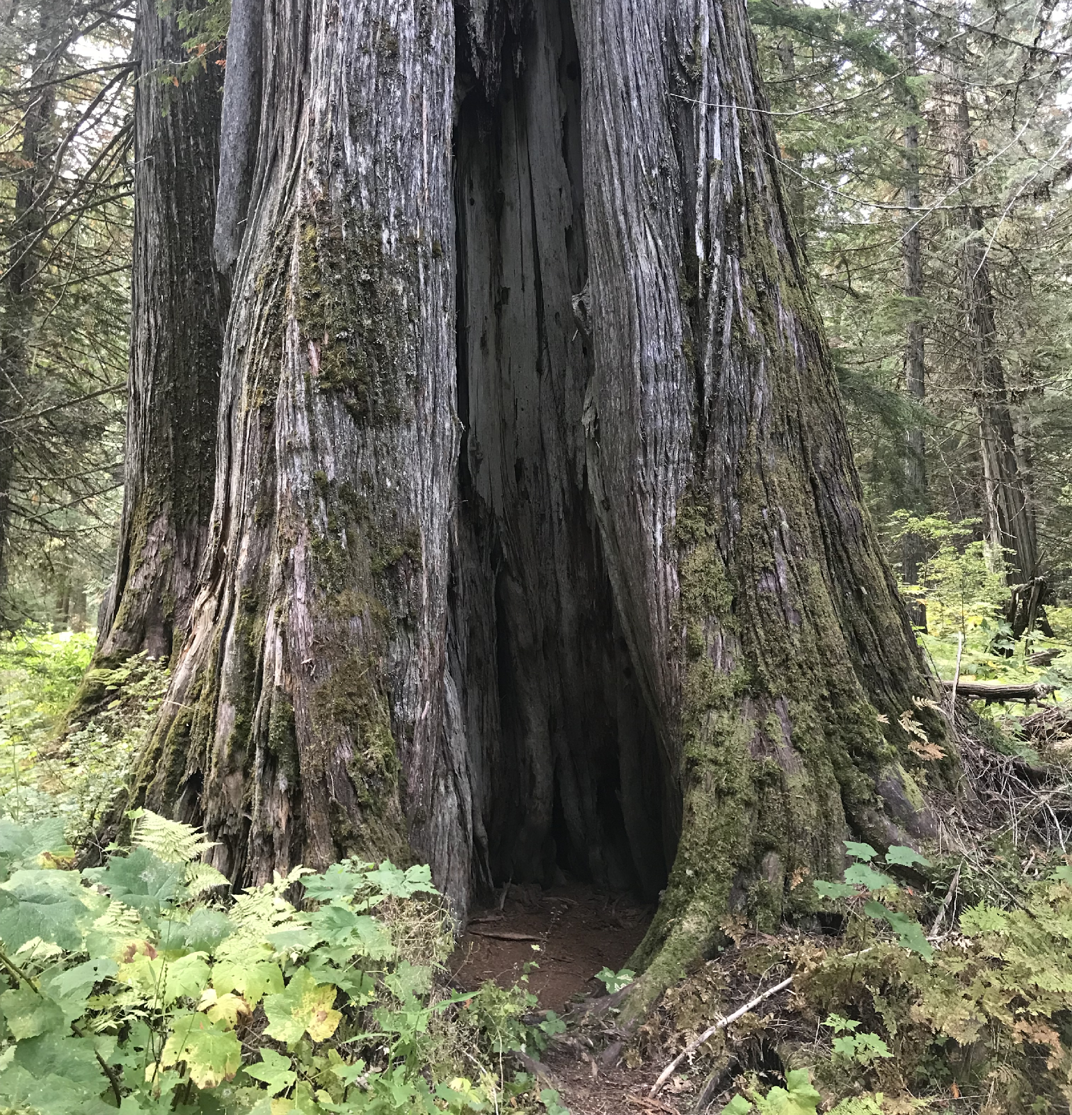
Revelstoke Complex and Central Selkirks Caribou Recovery Plan
The Landscape- Biodiversity
Additional caribou habitat protection will
  protect at-risk Old Growth forests,
  other species at risk (grizzly bears, wolverines, amphibians, and many plants)
  Increase watershed security,
  Support the health of fish spawning streams, including salmon and westslope cutthroat trout streams,
  store carbon and create carbon offsets,
  support implementation of the Nature Agreement, and BC’s commitment to protect 30% of ecosystems by 2030 (30X30)

